Slide 1

CoolTShirts.com Attribution
Learn SQL from Scratch
Rena Elion

Slide 2
Table of Contents
Getting to Know CoolTShirts
What is the user journey?
Optimize the campaign budget

Slide 3
1. Getting to Know CoolTShirts

Slide 4
1.1 Campaigns
Campaigns
getting-to-know-cool-tshirts
weekly-newsletter
ten-crazy-cool-tshirts-facts
retargetting-campaign
retargetting-ad
interview-with-cool-tshirts-founder
paid-search
cool-tshirts-search
CoolTShirts has 8 different campaigns. The campaign identifies the specific ad or email that is sent to their customers.
--How many campaigns--
select count(distinct utm_campaign)
from page_visits;
--What are the campaigns—
select distinct utm_campaign
from page_visits;

Slide 5
1.2 Sources
CoolTShirts.com has 6 different sources. The source identifies which site sent the traffic to CoolTShirts.com.
Sources
nytimes
email
buzzfeed
facebook
medium
google
--How many sources--
select count(distinct utm_source)
from page_visits;
--What are the sources--
select distinct utm_source
from page_visits;

Slide 6
1.3 Pages
Pages
1 - landing_page
2 – shopping_cart
3 - checkout
4 - purchase
CoolTShirts.com has 4 pages.
--How many pages--
select count(distinct page_name)
from page_visits;
--What are the pages—
select distinct page_name
from page_visits;

Slide 7
2. User Journey

Slide 8
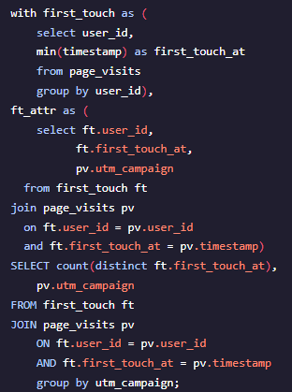
2.1 First Touch Analysis
How many first touches is each campaign responsible for?
Campaign | First Touch
Cool-tshirts-search | 169
Getting-to-know-cool-tshirts | 612
Interview-with-cool-tshirts-founder | 622
Ten-crazy-cool-tshirts-facts | 576

Slide 9
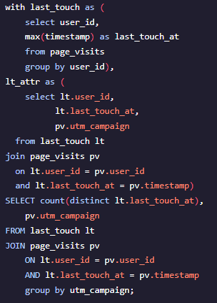
2.2 Last Touch Analysis
How many last touches is each campaign responsible for?
Campaign | Last Touch
Cool-tshirts-search | 60
Getting-to-know-cool-tshirts | 232
Interview-with-cool-tshirts-founder | 184
Paid-search | 178
Retargeting-ad | 443
Retargeting-campaign | 245
Ten-crazy-cool-tshirt-facts | 190
Weekly-newsletter | 447

Slide 10
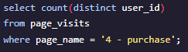
2.3 Total Purchases
How many visitors made a purchase?
- 361 visitors made a purchase.

Slide 11
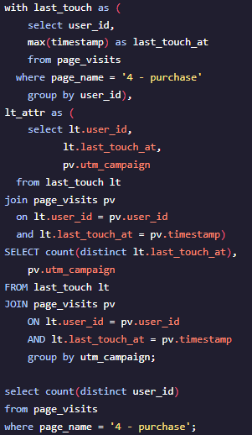
2.4 Last Touch Purchase Analysis
How many last touches on the purchase page is each campaign responsible for?
Campaign | Last Touch
Cool-tshirts-search | 2
Getting-to-know-cool-tshirts | 9
Interview-with-cool-tshirts-founder | 7
Paid-search | 52
Retargetting-ad | 113
Retargetting-campaign | 54
Ten-crazy=cool-tshirts-facts | 9
Weekly-newsletter | 115

Slide 12
2.5 Typical User Journey
The typical user journey starts from the interview with the founder. From there the customer makes their way from the landing page, to the shopping cart, to the checkout page and finally the purchase page. If a customer leaves the site before reaching the shopping cart, they typically reenter the site from the weekly newsletter email.

Slide 13
3. Optimize Campaign Budget

Slide 14
3.1 Campaigns to Reinvest in*
Getting to know Cool T-Shirts article in the NY Times – This article proved to be the campaign with the most touch points. Although the purchases that resulted from customers visiting the site from this campaign was low, it sets up the opportunity to retarget customers.
Interview with Cool T-Shirts founder – This campaign did not result in a lot of customers reaching the purchase page but it did bring a lot of customers to the site. This camping was both a first and last touch point for visitors and provides the opportunity to retarget customers.
Weekly Newsletter via email – This campaign resulted in the most purchases. Although it was not the most commonly touched campaign, it proved to have the most visitors reach the purchase page. The only downside to this is that it will never be a first touch campaign as it requires customers to already be on the mailing list. This is a better option over the email retargeting ad because it had more customers reach the purchase page.
Facebook Retargeting Ad – This campaign had the second most visitors reach the purchase page. It appears that customers are more likely to make a purchase when the campaign targets or reaches out to them. It was not as common for customers to make a purchase after the first touch.
Buzzfeed Ten Crazy Cool T-Shirt Facts article – This campaign had above average touch points but did not result in many customers reaching the purchase page. As with other campaigns that have both first and last touch points, there is the opportunity to retarget these customers.
* These are listed in no particular order. The strategy to combine all of these campaigns together would result in the most number of touch points and the highest number of visitors to reach the purchase page.

